Slide 1


PYTHON
Lecture 52

Slide 2

Today’s Agenda
Database Handling-III
Executing INSERT Command
Executing Dynamic Queries
Concept Of Bind Variables
Executing Update Command
Executing Delete Command

Slide 3
Inserting Record
To insert a new record in the table we have to execute the INSERT INTO command.
It has 2 syntaxes:
Insert into <table_name> values(<list of values>)
Insert into <table_name>(<list of cols> values(<list of values>)

Slide 4
Inserting Record
To insert a record in the table from our Python code we simply pass the insert query as argument to the execute( ) method of cursor object.
It’s general syntax is:
cur.execute(“insert query”)
Two important points:
After executing insert if we want to get the number of row inserted we can use the cursor attribute rowcount
Unless we call the method commit( ) of connection object , the record we insert does not get saved in the table

Slide 5
Steps Required For Inserting Records
For inserting record the overall steps are:
Import the module cx_Oracle
Establish a connection to the database.
Create a cursor to communicate with the data.
Execute the Insert query
Commit the changes
Close the connection to the database.

Slide 6
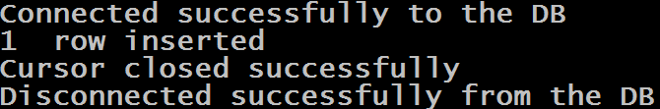
Example
import cx_Oracle
conn=None
cur=None
try:
conn=cx_Oracle.connect("scott/tiger@Sachin-PC/orcl")
print("Connected successfully to the DB")
cur=conn.cursor()
cur.execute("Insert into allbooks values(116,'Python Web Prog','Python',500)")
n=cur.rowcount
print(n," row inserted")
conn.commit()
except (cx_Oracle.DatabaseError)as ex:
print("Error in connecting to Oracle:",ex)
except (Exception) as ex:
print(ex)
finally:
if cur is not None:
cur.close()
print("Cursor closed successfully")
if conn is not None:
conn.close()
print("Disconnected successfully from the DB")

Slide 7
Executing Dynamic Queries
Dynamic queries are those where we set the values to be passed in the query at run time.
For example , we would like to accept the values of the record to be inserted from the user and then pass it to the insert query.
Such queries are called dynamic query

Slide 8
Executing Dynamic Queries
Dynamic queries for Oracle can be set using the concept of bind variables
Bind variables are like placeholders used in a query , represented using :some_name or :some_number, and are replaced with actual values before query execution.
They can be set in 2 ways:
Using position
Using name

Slide 9
Using bind variables By Position
In this Insert query :1,:2,:3 and :4 are called bind variables and they will be replaced with the values of the actual variables id,name,subject and price before the query is sent for execution. Also , parenthesis is required because these values are sent as a tuple
import cx_Oracle
conn=None
cur=None
try:
conn=cx_Oracle.connect("scott/tiger@Sachin-PC/orcl")
print("Connected successfully to the DB")
cur=conn.cursor()
id=int(input("Enter bookid:"))
name=input("Enter bookname:")
subject=input("Enter subject:")
price=int(input("Enter bookprice:"))
cur.execute("Insert into allbooks values(:1,:2,:3,:4)",(id,name,subject,price))
n=cur.rowcount
print(n," row inserted")
conn.commit()

Slide 10
Using bind variables By Position
import cx_Oracle
conn=None
cur=None
try:
conn=cx_Oracle.connect("scott/tiger@Sachin-PC/orcl")
print("Connected successfully to the DB")
cur=conn.cursor()
id=int(input("Enter bookid:"))
name=input("Enter bookname:")
subject=input("Enter subject:")
price=int(input("Enter bookprice:"))
myvalues=(id,name,subject,price)
cur.execute("Insert into allbooks values(:1,:2,:3,:4)",myvalues)
n=cur.rowcount
print(n," row inserted")
conn.commit()
Here we have first packed the variables id , name , subject and price into a tuple called myvalues and then we have passed it as argument to the method execute( )

Slide 11
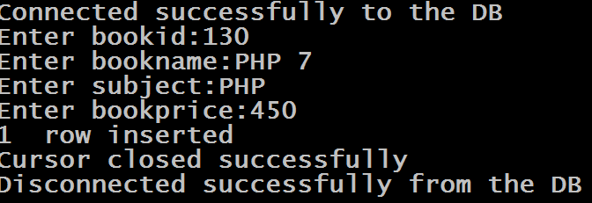
Sample Output

Slide 12
Using bind variables By Name
In this Insert query the bind variables :bid , :bname ,:sub and :amt have to be replaced with the values of the actual variables id,name,subject and price , by using dictionary or keyword arguments
import cx_Oracle
conn=None
cur=None
try:
conn=cx_Oracle.connect("scott/tiger@Sachin-PC/orcl")
print("Connected successfully to the DB")
cur=conn.cursor()
id=int(input("Enter bookid:"))
name=input("Enter bookname:")
subject=input("Enter subject:")
price=int(input("Enter bookprice:"))
cur.execute("Insert into allbooks values(:bid,:bname,:sub,:amt)",({'bid':id,'bname':name,'sub':subject,'amt':price}))
n=cur.rowcount
print(n," row inserted")
conn.commit()

Slide 13
Using bind variables By Name
In this Insert query the bind variables :bid , :bname ,:sub and :amt have to be replaced with replaced with the values of the actual variables id,name,subject and price , by using dictionary or keyword arguments
import cx_Oracle
conn=None
cur=None
try:
conn=cx_Oracle.connect("scott/tiger@Sachin-PC/orcl")
print("Connected successfully to the DB")
cur=conn.cursor()
id=int(input("Enter bookid:"))
name=input("Enter bookname:")
subject=input("Enter subject:")
price=int(input("Enter bookprice:"))
cur.execute("Insert into allbooks values(:bid,:bname,:sub,:amt)",bid=id,bname=name,sub=subject,amt=price)
n=cur.rowcount
print(n," row inserted")
conn.commit()

Slide 14
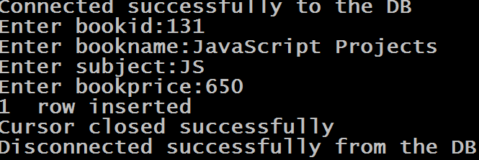
Sample Output

Slide 15
Important Points About bind variables
The number of bind variables and the number of actual values must always be the same.
When we pass bind variables by position it doesn’t matter what numbers we are using . For example , even this is also a valid query:
cur.execute("Insert into allbooks values (:1,:4,:6,:12)",(id,name,subject,price))

Slide 16
Important Points About bind variables
We even can use letters while giving names to bind variables used as position. So this query will also do the same job as previous queries:
cur.execute("Insert into allbooks values (:a,:b,:c,:d)",(id,name,subject,price))

Slide 17
Inserting Multiple Rows
To insert more than one row at a time we have 2 options in Python:
Run a loop , accept values from the user for each record and from the loop call the method execute( ) to send the query to the DB
Use cursor.prepare( ) and cur.executemany( ) methods

Slide 18
Solution 1
import cx_Oracle
conn=None
cur=None
n=0
try:
conn=cx_Oracle.connect("scott/tiger@Sachin-PC/orcl")
print("Connected successfully to the DB")
cur=conn.cursor()
while True:
id=int(input("Enter bookid:"))
name=input("Enter bookname:")
subject=input("Enter subject:")
price=int(input("Enter bookprice:"))
cur.execute("Insert into allbooks values(:1,:2,:3,:4)",(id,name,subject,price))
n=n+cur.rowcount
print("Any more(y/n)?")
choice=input()
if choice=="n":
break
print(n," rows inserted")
conn.commit()

Slide 19
Solution 1
except (cx_Oracle.DatabaseError)as ex:
print("Error in connecting to Oracle:",ex)
except (Exception) as ex:
print(ex)
finally:
if cur is not None:
cur.close()
print("Cursor closed successfully")
if conn is not None:
conn.close()
print("Disconnected successfully from the DB")

Slide 20
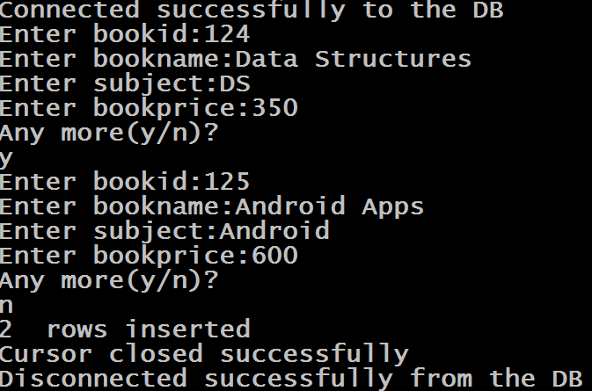
Sample Output

Slide 21
Problems With Solution 1
This works as expected and 2 rows are inserted into the table.
But each execution, however, requires a "round-trip" to the database.

Slide 22
Problems With Solution 1
A round-trip is defined as the client (i.e. the Python script) making a request to the database and the database sending back its response to the client.
In this case, 2 round-trips are required and as the number of executions increases, the cost of execution will also increases

Slide 23
Solution 2
The second solution is to use the methods:
prepare( ) and
executemany( )
of cursor object.
The method prepare( ) accepts an SQL statement with bind variables
For example:
cur.prepare("Insert into allbooks values(:1,:2,:3,:4)")

Slide 24
Solution 2
Then we call the method executemany( ) of cursor object.
This method accepts a sequence of values and then executes the query set in prepare( ) method for each sequence found in the sequence of values
For example:
cur.executemany(None, mylist)
Here mylist is a list containing multiple set of records where
each record is a tuple holding values for one row

Slide 25
Benefit Of Solution 2
In this case there is only one round-trip to the database, not multiple.
In fact, no matter how many rows are processed at the same time there will always be just one round-trip.

Slide 26
Solution 2
import cx_Oracle
conn=None
cur=None
try:
conn=cx_Oracle.connect("scott/tiger@Sachin-PC/orcl")
print("Connected successfully to the DB")
cur=conn.cursor()
cur.prepare("Insert into allbooks values(:1,:2,:3,:4)")
mybooks=[]
while True:
id=int(input("Enter bookid:"))
name=input("Enter bookname:")
subject=input("Enter subject:")
price=int(input("Enter bookprice:"))
mybooks.append((id,name,subject,price))
print("Any more(y/n)?")
choice=input()
if choice=="n":
break
cur.executemany(None,mybooks)
n=cur.rowcount
print(n," rows inserted")
conn.commit()

Slide 27
Solution 2
except (cx_Oracle.DatabaseError)as ex:
print("Error in connecting to Oracle:",ex)
except (Exception) as ex:
print(ex)
finally:
if cur is not None:
cur.close()
print("Cursor closed successfully")
if conn is not None:
conn.close()
print("Disconnected successfully from the DB")

Slide 28
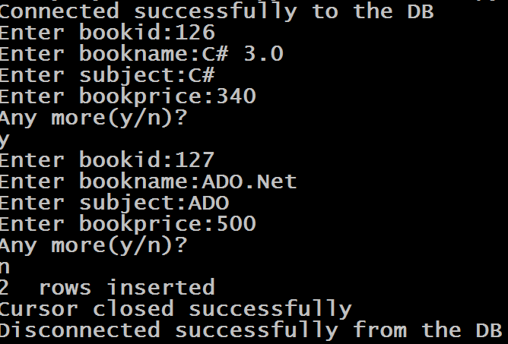
Sample Output

Slide 29
Updating Record
To update a record in the table we have to execute the UPDATE command.
It has 2 syntaxes:
Update <table name> set <col name>=<value>
Update <table name> set <col name>=<value> where <test condition>

Slide 30
Updating Record
Updating a record through Python code is same as inserting a new record. .
We call the method execute( ) of cursor object passing it the update query.
It’s general syntax is:
cur.execute(“update query”)
If the query is dynamic then we can use bind variables for setting the values at run time.

Slide 31
Example
import cx_Oracle
conn=None
cur=None
try:
conn=cx_Oracle.connect("scott/tiger@Sachin-PC/orcl")
print("Connected successfully to the DB")
cur=conn.cursor()
cur.execute("Update allbooks set bookprice=500 where bookid=125 ")
n=cur.rowcount
print(n," rows updated")
conn.commit()
except (cx_Oracle.DatabaseError)as ex:
print("Error in connecting to Oracle:",ex)
except (Exception) as ex:
print(ex)
finally:
if cur is not None:
cur.close()
print("Cursor closed successfully")
if conn is not None:
conn.close()
print("Disconnected successfully from the DB")

Slide 32
Exercise
Write a program to accept a subject name and an amount from the user and increase the price of all the books of the given subject by adding the amount in the current price. Finally display whether books were updated or not and how many books were updated

Slide 33
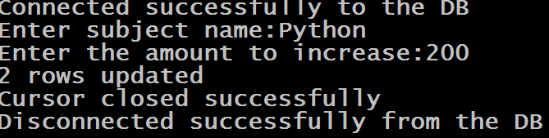
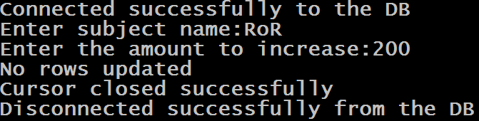
Sample Output
Sample Run 1
Sample Run 2

Slide 34
Solution
import cx_Oracle
conn=None
cur=None
try:
conn=cx_Oracle.connect("scott/tiger@Sachin-PC/orcl")
print("Connected successfully to the DB")
subject=input("Enter subject name:")
amount=int(input("Enter the amount to increase:"))
cur=conn.cursor()
cur.execute("Update allbooks set bookprice=bookprice+:1 where subject=:2",(amount,subject))
n=cur.rowcount
if n==0:
print("No rows updated")
else:
print(n, "rows updated")
conn.commit()
except (cx_Oracle.DatabaseError)as ex:
print("Error in connecting to Oracle:",ex)
except (Exception) as ex:
print(ex)
finally:
if cur is not None:
cur.close()
print("Cursor closed successfully")
if conn is not None:
conn.close()
print("Disconnected successfully from the DB")

Slide 35
Deleting Record
To delete a record from the table we have to execute the DELETE command.
It has 2 syntaxes:
Delete from <table name>
Delete from <table name> where <test condition>

Slide 36
Deleting Record
Deleting a record through Python code is same as updating/inserting a record. .
We call the method execute( ) of cursor object passing it the delete query.
It’s general syntax is:
cur.execute(“delete query”)
If the query is dynamic then we can use bind variables for setting the values at run time.

Slide 37
Example
import cx_Oracle
conn=None
cur=None
try:
conn=cx_Oracle.connect("scott/tiger@Sachin-PC/orcl")
print("Connected successfully to the DB")
cur=conn.cursor()
cur.execute("Delete from allbooks where bookid=131")
n=cur.rowcount
print(n," row deleted")
conn.commit()
except (cx_Oracle.DatabaseError)as ex:
print("Error in connecting to Oracle:",ex)
except (Exception) as ex:
print(ex)
finally:
if cur is not None:
cur.close()
print("Cursor closed successfully")
if conn is not None:
conn.close()
print("Disconnected successfully from the DB")

Slide 38
Exercise
Write a program to accept a subject name from the user and delete all the books of the given subject .Finally display whether books were deleted or not and how many books were deleted

Slide 39
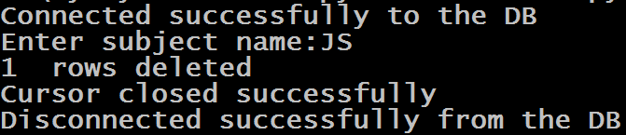
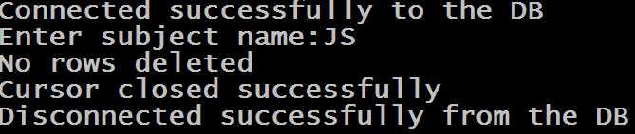
Sample Output
Sample Run 1
Sample Run 2

Slide 40
Solution
import cx_Oracle
conn=None
cur=None
try:
conn=cx_Oracle.connect("scott/tiger@Sachin-PC/orcl")
print("Connected successfully to the DB")
cur=conn.cursor()
subject=input("Enter subject name:")
cur.execute("Delete from allbooks where subject=:1",(subject,))
n=cur.rowcount
if n==0:
print("No rows deleted")
else:
print(n," rows deleted")
conn.commit()
except (cx_Oracle.DatabaseError)as ex:
print("Error in connecting to Oracle:",ex)
except (Exception) as ex:
print(ex)
finally:
if cur is not None:
cur.close()
print("Cursor closed successfully")
if conn is not None:
conn.close()
print("Disconnected successfully from the DB")

